Slide 1
NO, NOT ONE!

Slide 2
Lowly : hạ mình / khiêm nhường
Heal : chữa lành
Soul : linh hồn
Disease : bệnh tật
Struggle : chiến đấu / chống lại
Guide : hướng dẫn / dẫn dắt
Till : cho đến

Slide 3
Lowly
Heal
Soul
Disease
Struggle
Guide
Till

Slide 4
____ : chữa lành
____ : chiến đấu / chống lại
____ : linh hồn
____ : hướng dẫn / dẫn dắt
____ : hạ mình / khiêm nhường
____ : bệnh tật
____ : cho đến

Slide 5
High: cao / cao sang/ cao lớn..
Holy: Thần Thánh
Meek: nhu mì/ ngoan ngoãn (=lowly)
Hour: thời gian
Near: gần
Night: đêm
Dark: tối tăm

Slide 6
Cheer: khích lệ / tạo niềm vui
Saint: Thánh
Find: tìm kiếm
Forsake: từ bỏ, bỏ rơi
Sinner: người có tội
Gift: quà
Savior: Đấng Cứu Thế

Slide 7
There's not a friend
like the lowly Jesus,
No, not one! No, not one!
None else could heal
all our soul's diseases,
No, not one! No, not one!

Slide 8
Jesus knows all about
our struggles,
He will guide till the day is done;
There's not a friend
like the lowly Jesus,
No, not one! No, not one!

Slide 9
No friend like Him
is so high and holy,
No, not one! No, not one!
And yet no friend is
so meek and lowly,
No, not one! No, not one!

Slide 10
Jesus knows all about
our struggles,
He will guide till the day is done;
There's not a friend
like the lowly Jesus,
No, not one! No, not one!

Slide 11
There's not an hour that
He is not near us,
No, not one! No, not one!
No night so dark but
His love can cheer us,
No, not one! No, not one!

Slide 12
Jesus knows all about
our struggles,
He will guide till the day is done;
There's not a friend
like the lowly Jesus,
No, not one! No, not one!

Slide 13
Did ever saint find this Friend forsake him?
No, not one! No, not one!
Or sinner find that He would not take him?
No, not one! No, not one!

Slide 14
Jesus knows all about
our struggles,
He will guide till the day is done;
There's not a friend
like the lowly Jesus,
No, not one! No, not one!

Slide 15
Was ever a gift like the Savior given?
No, not one! No, not one!
Will He refuse us a home in heaven?
No, not one! No, not one!

Slide 16
Jesus knows all about
our struggles,
He will guide till the day is done;
There's not a friend
like the lowly Jesus,
No, not one! No, not one!

Slide 17
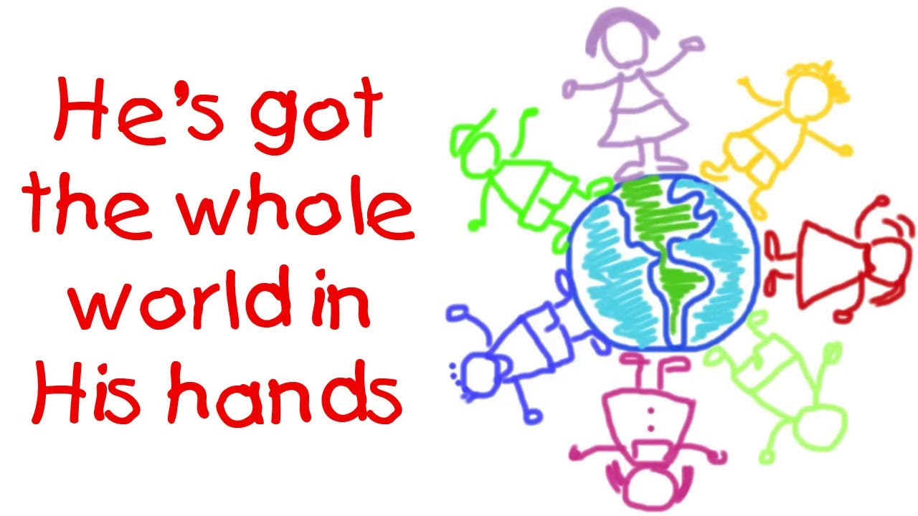

Slide 18

He's got the whole world in His hands
He's got the whole world in His hands
He's got the whole world in His hands
He's got the whole world in His hands.

Slide 19

He's got you and me, daddy in His hands
He's got you and me, daddy in His hands
He's got you and me, daddy in His hands
He's got the whole world in His hands.

Slide 20
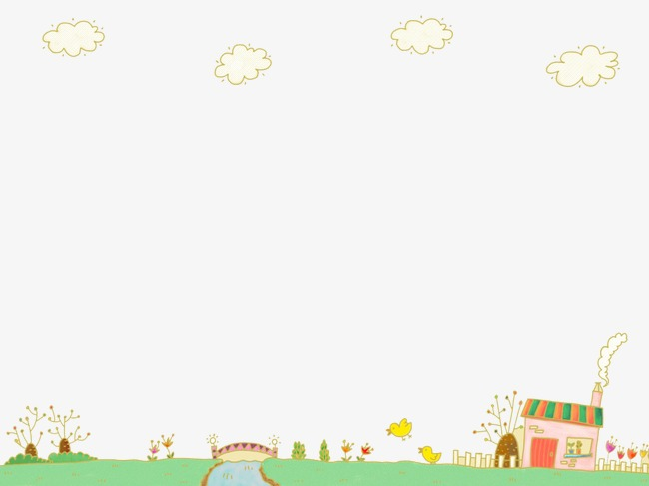
He's got you and me, mommy in His hands,
He's got you and me, mommy in His hands,
He's got you and me, mommy in His hands,
He's got the whole world in His hands.

Slide 21
He's got you and me, family in His hands,
He's got you and me, family in His hands,
He's got you and me, family in His hands,
He's got the whole world in His hands.

